Slide 1
Streaming Anomaly Detection Urban Data Lab Capstone Project Week 4 Status
Data 599 Mitch Harris, Ryan Koenig, Nathan Smith May 25, 2021

Slide 2
Outline
Previous Week Summary (May 17-23)
Next Week Planning (May 24-30)
Timeline Reflection

Slide 3
Previous Week Summary
Week 3 Goals: Anomaly Detection Model
Data Cleaning/Feature Processing for Anomaly Detection Pipeline
Test Short-Listed Anomaly Detection Methods
Build Streaming Framework for Anomaly Detection Model with InfluxDB
Meet with Domain Experts
Start Reviewing Azure (secondary)

Slide 4
Ongoing from Week 2 Tasks Previous Week (May 17-23)
Exploratory Data Analysis - Ryan
EDA originally completed on the limited dataset
Time intensive method of downloading data
Additional work supporting UDL with parsing data to be uploaded and streamed
Additional support on implementing the streaming parser
Complete but ended up being ~1 week behind schedule

Slide 5
Ongoing from Week 2 Tasks Previous Week (May 17-23)
Anomaly Detection Research (and start testing) – Mitch/Ryan
Decided we needed additional time on coming up with the anomaly detection method
Risk of going down the wrong path too high (high diversity of methods)
Now have a two methods that we’re planning on building
Part of this was driven by uncertainty in data with delay in EDA
Complete but ended up being ~1 week behind schedule

Slide 6
Ongoing from Week 2 Tasks Previous Week (May 17-23)
Couple of slides here explaining what framework we’re looking at/why

Slide 7
New Week 3 Tasks Previous Week (May 17-23)
Build Streaming Framework - Nate
Built initial framework (code) that could work with InfluxDB/Telegraf
Includes querying/parsing/writing data
Options coded for inline Telegraf prediction or query/write from InfluxDB prediction
Stopped at a point where details on model are now required
Tests in local Docker setup successful
On track

Slide 8



New Week 3 Tasks Previous Week (May 17-23)
Anomaly Detection inline w/ Telegraf
Anomaly Detection using Query/Write
Raw
Parsed
Detected

Slide 9
New Week 3 Tasks Previous Week (May 17-23)
Meet with Domain Experts - All
Monday meeting – sounds like we’ll be unable to get labelled data
Friday meeting - …
On track

Slide 10
New Week 3 Tasks Previous Week (May 17-23)
Data Cleaning/Feature Engineering Pipeline
Did not get worked on with EDA behind schedule
Build/Test Anomaly Detection Frameworks
Did not get worked on with EDA behind schedule
Will be working on in coming week

Slide 11
New Week 3 Tasks Previous Week (May 17-23)
Review Azure
This was a secondary goal and did not get looked into
Pushing this further out (ultimately a secondary objective)

Slide 12
Client Meetings Previous Week (May 17-23)
Monday Technical Project Meeting
Discussion on streaming framework, our approach seems reasonable
Thursday Sprint Planning
Discuss data parsing and EDA issues
Plan for next week tasks

Slide 13
Challenges Previous Week (May 17-23)
Getting Data
Current method is time consuming (manual csv downloads)
Complete dataset is still not easily accessible
Data Parsing to Support Streaming into InfluxDB
Support was still being provided for this
Anomaly Detection Model
Felt we needed to do additional research before moving forward

Slide 14
Challenges Previous Week (May 17-23)
Anomalies / Performance Measures
Realized that we need to do our own anomaly labelling
Didn’t build time to understand/select anomaly detection performance measures into the schedule

Slide 15
Next Week Planning
Week 4 Goals: Implement Streaming Pipeline
Streaming Anomaly Detection Pipeline
Model Tuning and Evaluate Performance
Status Presentation

Slide 16
New Goal/Tasks Next Week (May 24-30)
Week 4 Goal: Build Anomaly Detection Model
Label Anomalies and Select Performance Measures (tasks not originally considered)
Data Cleaning/Feature Pipeline
Build Anomaly Detection Model
Status Presentation
Start Implementing Detection Pipeline as Possible
Model Tuning and Evaluate Performance as Possible

Slide 17
Individual Tasks Next Week (May 17-23)
Mitch: Build Anomaly Detection Model
Ryan: Label Anomalies, Performance Measures, Support Anomaly Detection Model (focus on cleaning/features)
Nate: Project Management, Status Presentation, Support Mitch/Ryan as Needed (streaming framework on hold)

Slide 18
Challenges Next Week (May 17-23)
Behind where we wanted to be
Week 4 is basically Week 3 – lost float
Anomaly labelling
Hopefully this doesn’t prove too time consuming

Slide 19
Timeline Reflection
Discussion on where we’re at

Slide 20
Schedule Timeline Reflection
Week 3:
Anomaly detection model not built
Streaming framework on track
Week 4:
Not implementing model yet
Added task of anomaly labelling and performance measures
Week | Goal
1 | Project Definitional and Proposal
2 | Data and System Understanding
3 | Anomaly Detection Model
4 | Implement Streaming Pipeline
5 | Value Week
6 | Dashboard
7 | Reporting

Slide 21
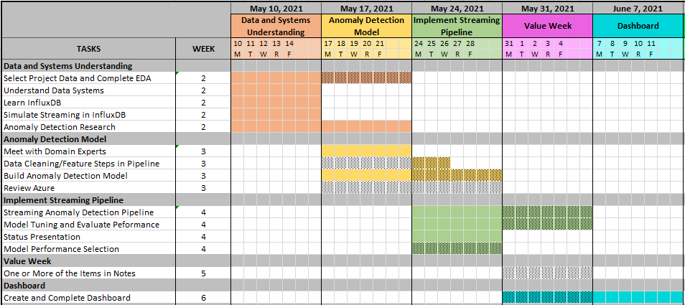
Schedule Timeline Reflection

Slide 22
Impacts to Scope Timeline Reflection
Behind where we wanted to be at the start of Week 4
Plan was:
Week 2 was research/understanding
Week 3 is testing/building
Week 4 is implementing
Week 5 is a value add/buffer week
Week 4 is becoming testing/building and Week 5 implementing – No longer have float

Slide 23
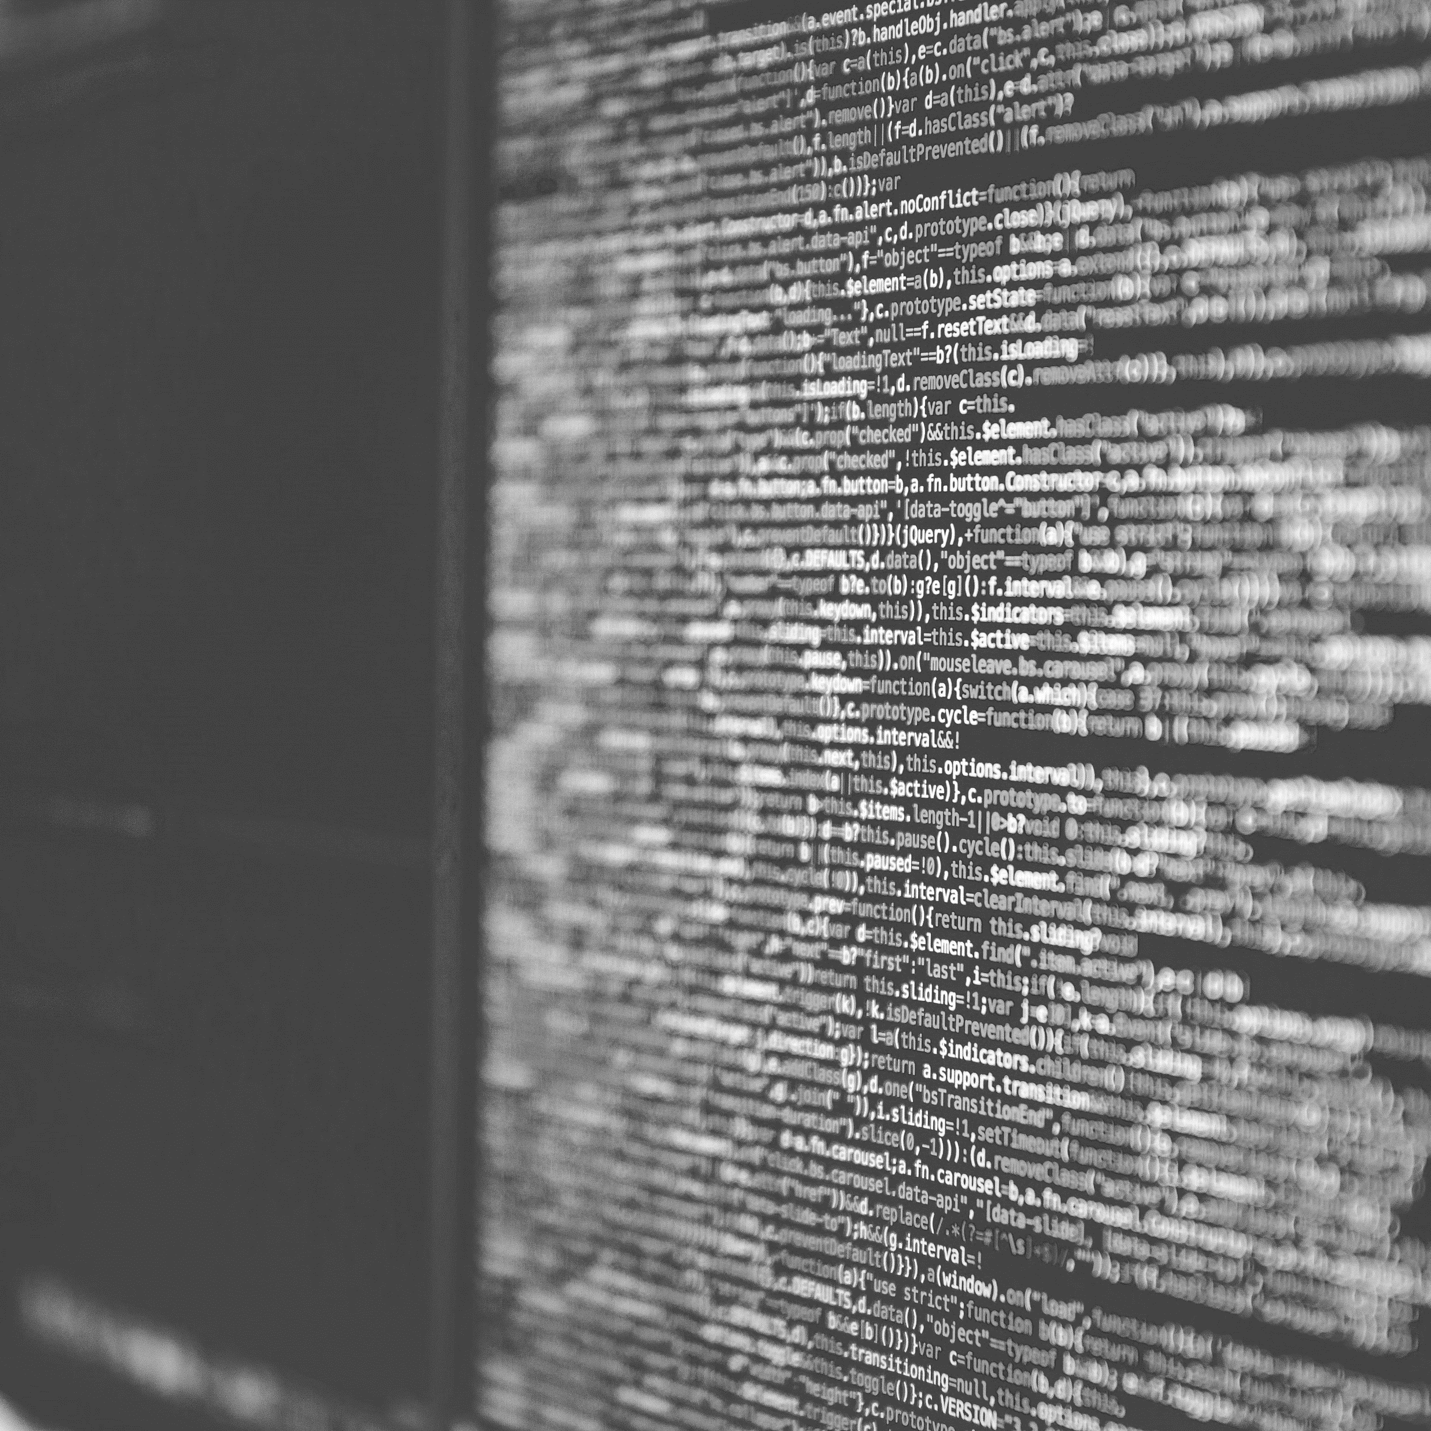
Thank You
Mitch Harris
Ryan Koenig
Nathan Smith
Photo by Markus Spiske on Unsplash

